Slide 1
Using Docker Containers to Deploy Probabilistic Machine Learning Models into Production
Moeketsi Mosia
Centre for Teaching, Learning and Programme Development
Our team: Potso(MSc Astrophysics), Eli (Candidate MSc eScience), Taryn (Candidate MSc eScience), Mel (Candidate BSc Hons CS)
https://github.com/moeketsims/researchday

Slide 2
My Personal Interest
Full lifecycle of Machine Learning Models
Authentic Learning
Deploying Probabilistic Machine Learning Model
Industry Collaboration

Slide 3
Problem of Interest
The effective deployment of Machine Learning as fast as possible
Deploying probabilistic machine learning models.
Prediction in a probabilistic machine learning setting is a simulation
critical reflections on my experiences in building and deploying probabilistic machine learning models in collaborative projects.

Slide 4
Model Building: Probabilistic Model

Slide 5
Machine Learning: A Probabilistic Perspective
Neil Lawrence’s perspective is useful:
Statistics:
Turns humans into computers – remove your bias from seeing patterns
Machine learning:
Turns computers into humans – introduces human bias into computers.
Both use: Calculus of Uncertainty

Slide 6
What is Machine Learning
Data + Model = Prediction

Slide 7
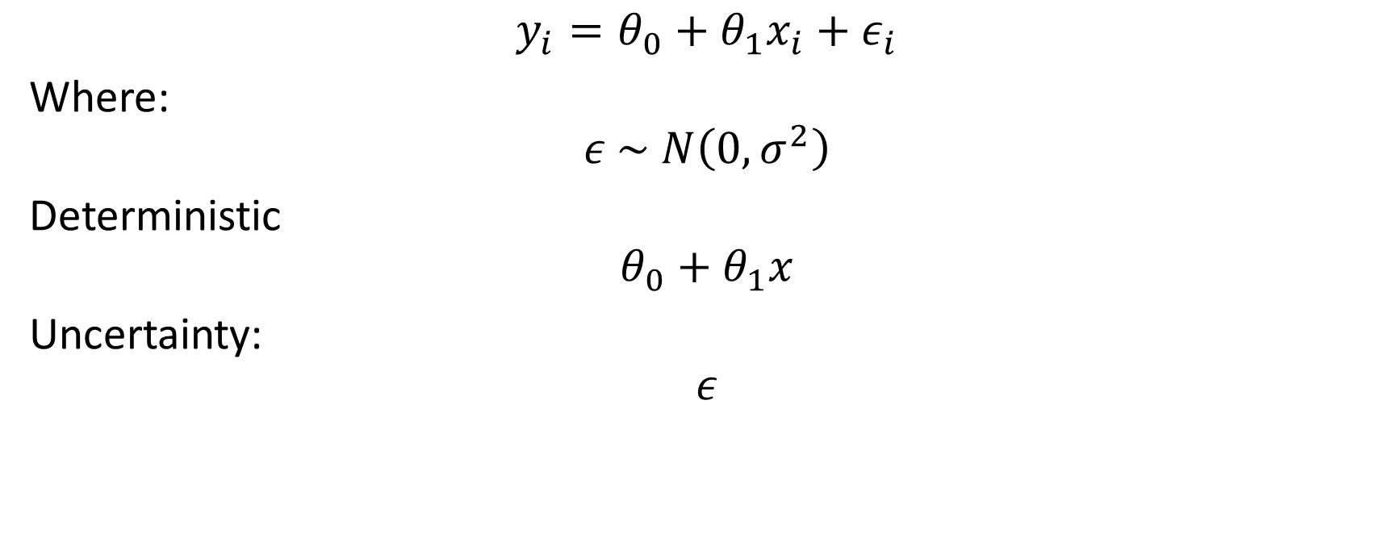
Uncertainty
$$y_{i}=θ_{0}+θ_{1}x_{i}+ε_{i}$$
Where:
$$ε \sim N\left(0,σ^{2}\right)$$
Deterministic
$$θ_{0}+θ_{1}x$$
Uncertainty:
$$ε$$

Slide 8
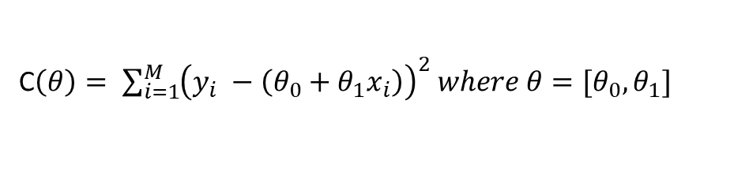
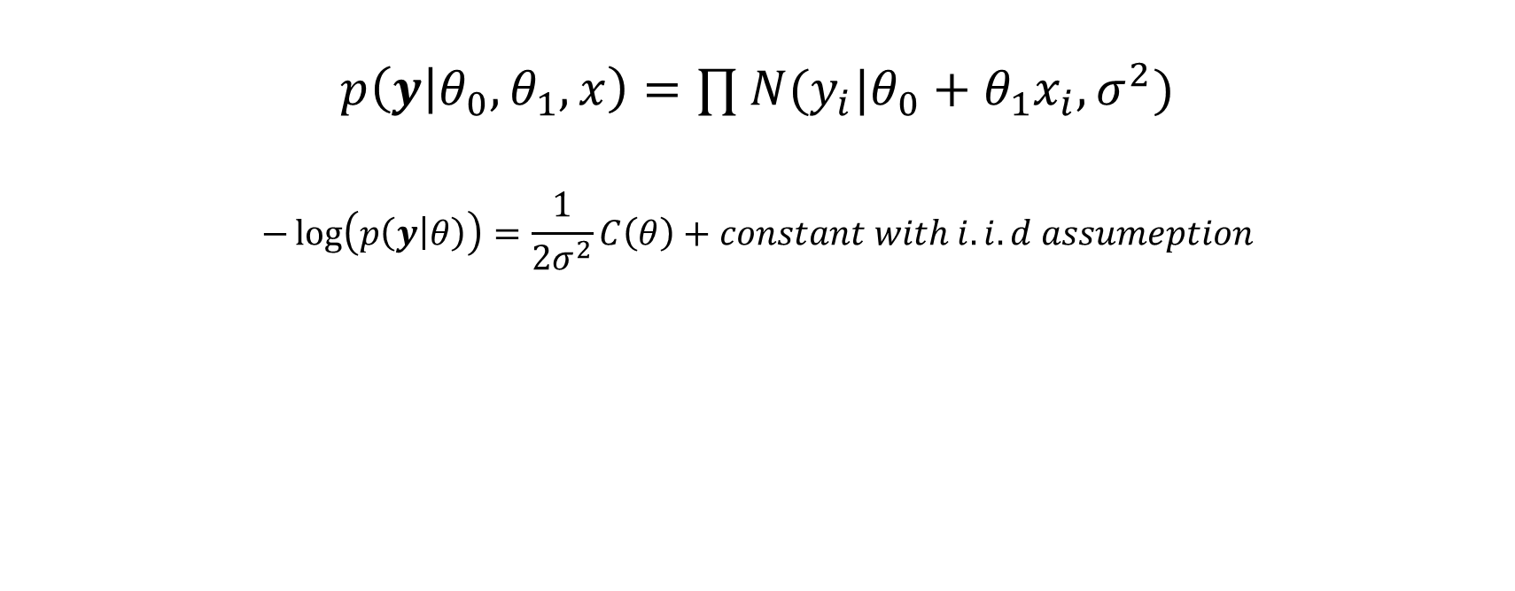
Learning – Maximising Probability vs minimizing the Cost function
$$p\left(y | θ_{0},θ_{1},x\right)=∏ N(y_{i}|θ_{0}+θ_{1}x_{i}, σ^{2})$$
$$−\log\left(p\left(y | θ\right)\right)=\frac{1}{2σ^{2}}C\left(θ\right)+constant with i.i.d assumeption$$
Supervised Learning
C$\left(θ\right)= \sum_{i=1}^{M}{{\left(y_{i} −\left(θ_{0}+θ_{1}x_{i}\right)\right)}^{2} where θ=[θ_{0}, θ_{1}]}$
Choose to focus Data Generative Model

Slide 9
Use-Case

Slide 10
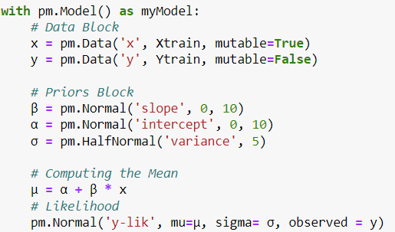
Python: Bayesian Framework

Slide 11
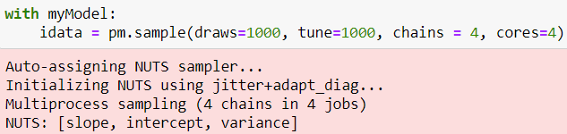
Bayesian Learning

Slide 12
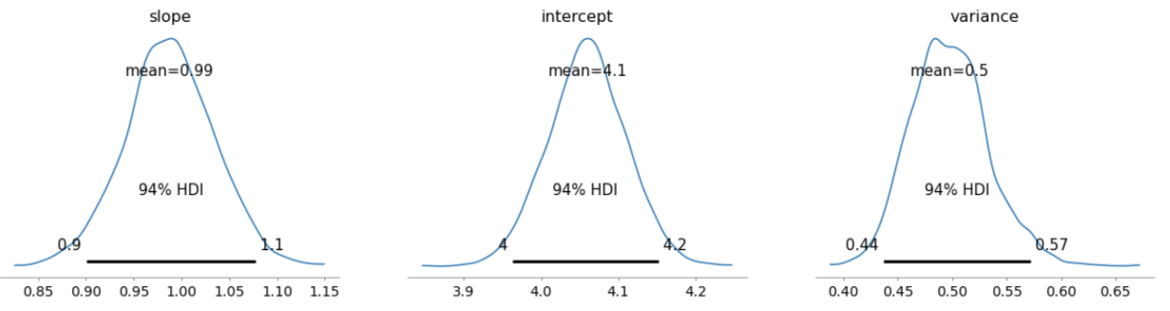
Uncertainty in Parameter Estimation

Slide 13
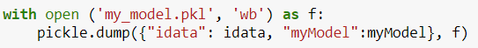
Model Saving For Deployment
You need them both

Slide 14
Creating Machine Learning Model API

Slide 15
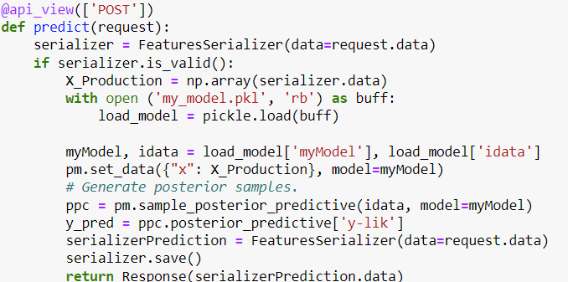

Slide 16
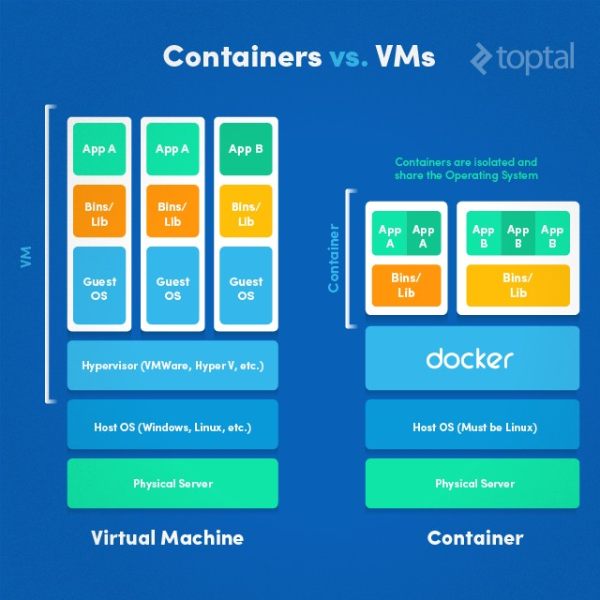

Slide 17
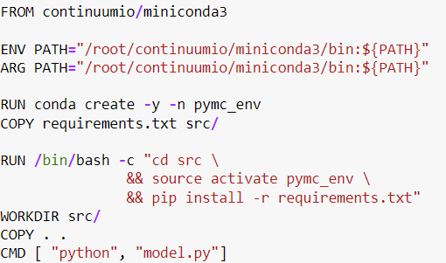
MLOps with Docker Containers

Slide 18
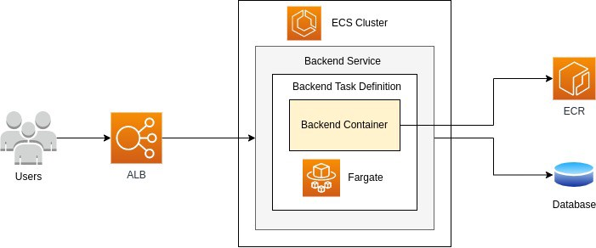
Cloud-Development

Slide 19
Conclusion

Slide 20
Lessons Learnt: Critical Reflections
Bayesian Machine Learning Models are Intuitive
Learning moves from solving an Optimisation problem to Integral Approximation
Integral Approximation can be complex for Complex Models
Docker Containers seem to be able to solve the problem
Containers can auto-scale
However, the high costs managed
Kubernetes – for scaling

Slide 21
Thank you!
(+27) 53 491 0252
(+27)
moeketsi.mosia@spu.ac.za

